Slide 1
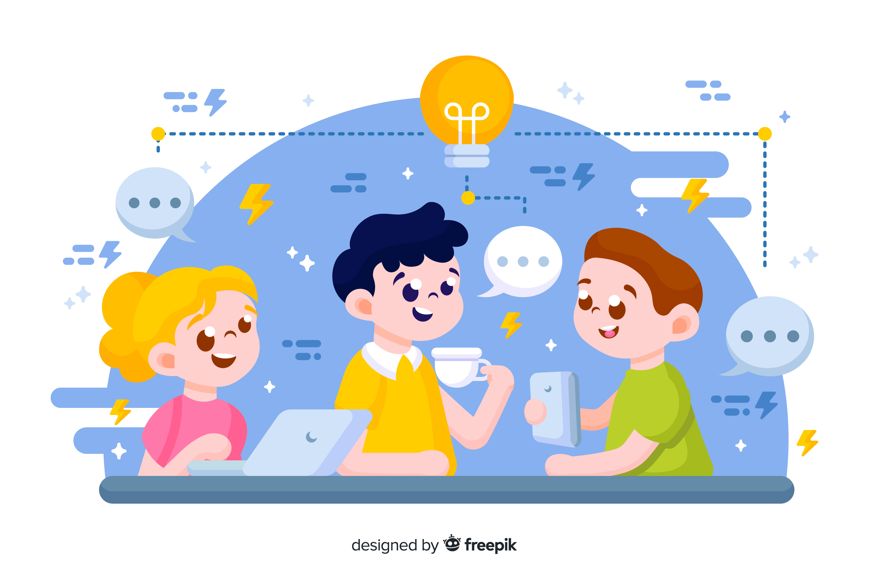
Learn Programming For Kids (Python)

Slide 2
Lesson 10
Fun Activities – Python Projects for Kids

Slide 3
13. Python Projects for Kids
To make learning Python more exciting, here are a few project ideas for kids:

Slide 4
Project 1. Simple Calculator

Slide 5
Project Description:
Create a simple calculator which can perform basic arithmetic operations like addition, subtraction, multiplication, or division depending upon the user input. Approach :
User chooses the desired operation. Options 1, 2, 3, and 4 are valid.
Two numbers are taken and an if…elif…else branching is used to execute a particular section.
Using functions add(), subtract(), multiply() and divide() evaluate respective operations.

Slide 6
Project 2. Guess the Number

Slide 7
Project Description:
This project involves generating a random number and letting the user guess it.
It generates a random number.
Allows the user to guess a number.
If the guessed input number is smaller than the generated number, a message "Too low!" is printed. If it is larger, it prints the message "Too high!" Until you enter the correct number

Slide 8
Project 3. Simple To-Do List

Slide 9
Project Description:
This project introduces basic list manipulation. Children can add, remove, and display items in a to-do list.

Slide 10
Project 4. Simple Text-Based Adventure Game

Slide 11
Project Description:
Develop a text-based adventure game where the player makes choices to navigate through different scenarios and reach an end goal.

Slide 12
Project 5. BMI Calculator

Slide 13
Project Description:
Create a program that calculates and displays the Body Mass Index (BMI) based on the user's height and weight.

Slide 14
Project 6. Simple Drawing Program

Slide 15
Project Description:
This project introduces basic graphical user interface (GUI) concepts using the ‘turtle’ module. Children can draw shapes and patterns.

Slide 16
Project 7. Rock, Paper, Scissors Game

Slide 17
Project Description:
Create a Rock, Paper, Scissors game where the user plays against the computer. The computer's choice should be random.

Slide 18
Project 8. Password Generator

Slide 19
Project Description:
Build a password generator that creates a strong password based on user-defined criteria such as length and character types (letters, digits, symbols).

Slide 20
Project 9. Contact Book

Slide 21
Project Description:
Create a contact book where users can add, view, and delete contacts. Each contact should have a name and a phone number.

Slide 22
Project 10. Simple Quiz

Slide 23
Project Description:
Create a simple quiz program that asks the user multiple-choice questions and provides a score at the end.

